Slide 1
Capstone Project 2019
IOS Team
Technical Presentation

Slide 2
Requirements Engineering

Slide 3
Constraints
Time
Experience
The Client
&
Domain Knowledge

Slide 4
Methodology & Lessons Learned
Requirements Engineers
Team
Client

Slide 5
Project Management (Responsibilities)
Use cases
Requirements
Architecture
Prototyping
Use case prototyping
API
Development

Slide 6
Project Management (Methodologies)
AGILE
Sprint
Scrum
GITLAB
Ticket
Kanban
REPOSITORY
Branch
Wiki

Slide 7
Project Management (Flow)
Ticket
Topic
Acceptance Criteria
Workflow
Project Manager
Task distribution
Roles
Expertise
Responsible Person
Developers
Developer
Tester
Project Manager

Slide 8
Project Management (Tools)
Daily scrum
Documentation
Communication
Pair programming

Slide 9
Project Management (Improvements)
Gitlab
CI/CD
Tags
Communication
Scrum
Retrospective
Ticket
Story point
Estimation
Timesheet

Slide 10
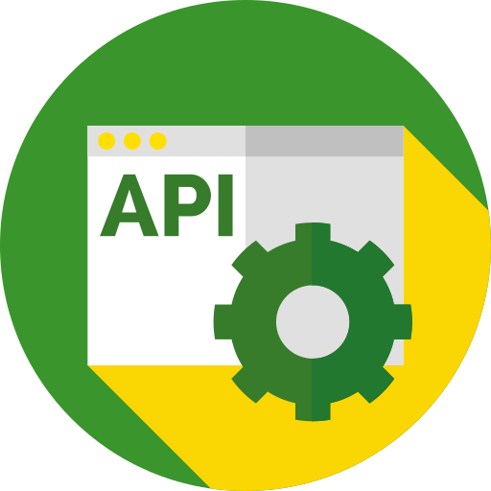

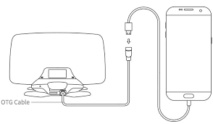
JD API Integration
JD API
JDOrganization
HTTP
JDField
...

Slide 11
JD API Integration: What we did?
Manual integration
JD Login
Show JDLogin screen and be able to authenticate
JD Framework
Framework in Objective-C is integrated into Swift app.
Alomofire for Swift
Could authenticate and fetch data
JD Organizations
Fetch list of organizations and and list of fields within an organization

Slide 12
JD API Integration: Challenges
JD API Documentation (README.md)
Technical implementation issues

Slide 13
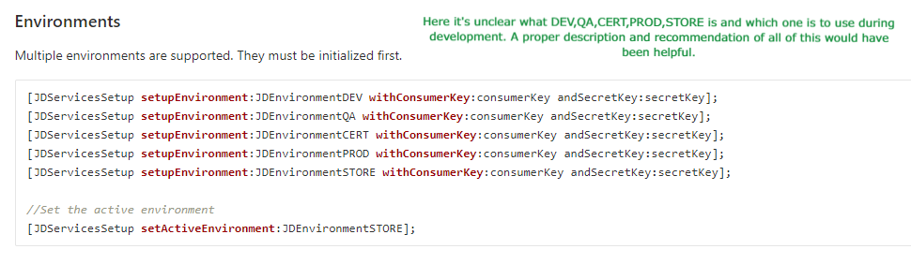
JD API Integration: Documentation issues

Slide 14
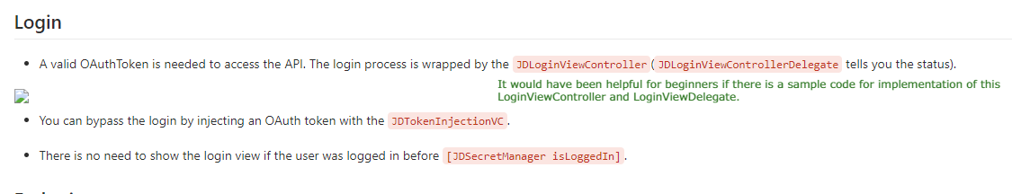
JD API Integration: Documentation issues

Slide 15
JD API Integration: Technical issues
JD Framework
In Objective-C
Swift and Mobile development experience
Nobody had Mobile Application development experience
Required bridging implementation
No prior knowledge of Swift

Slide 16
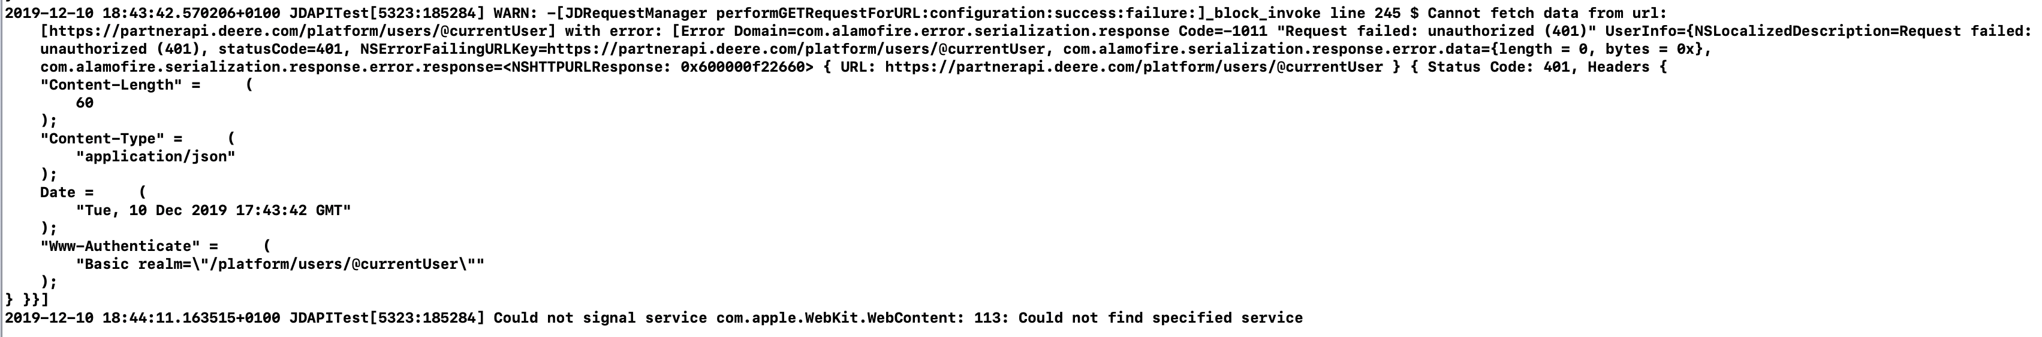
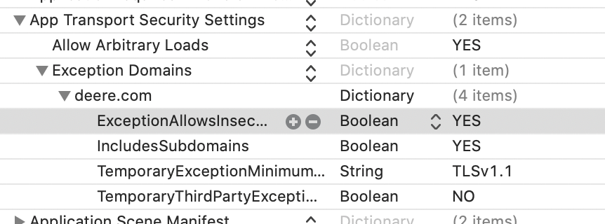
JD API Integration: Important Observations
JD Login
Default Storyboard must be deleted
JDLoginViewController initialized in SceneDelegate
Misleading Error messages
Probably bug of XCode

Slide 17
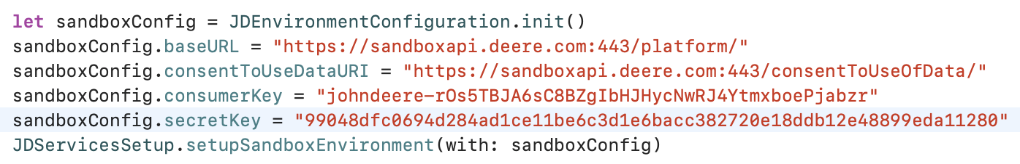
JD API Integration: Important Observations
JD fetch data

Slide 18
Quality Assurance & Testing

Slide 19
Our Approaches
Quality Assurance:
Functional Testing
Non-Functional Testing
Quality Assurance
Code Quality
Performance Testing

Slide 20
Quality Assurance

Slide 21
Summary
Quality Assurance:
Findings
Uni Testing
Difficulties
Environment
Process
pair programming

